Slide 1
Multimodal Hate Speech Detection

Slide 2

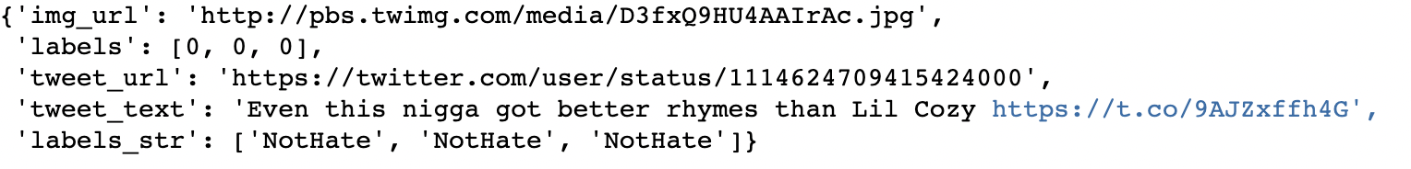
Objective/Dataset
To identify hate content based text and image data
The dataset contains 150K tweets and corresponding images and is present on Kaggle
We plan to reproduce the results from the paper

Slide 3
What we did
Tried to simplify the problem by taking the mode of the 3 annotators
We then created two classes from the six classes i.e. 0 - NotHate, 1 - Racist, 2 - Sexist, 3 - Homophobe, 4 - Religion, 5 - OtherHate. NotHate as class 0 and rest of the classes as class 1

Slide 4
Text Model
Text was initially tokenized using spacy
Tokenized text was then lemmatized and each unique lemmatized token was assigned a unique number
These unique number was used as an identifier to fetch embedding that was then used to train an LSTM model
We also weighted the loss function to counter class imbalances

Slide 5
Image Model
Dimensions of image present in the dataset is not fixed. Therefore, we resized all the image to dimension of 224x224. We chose this dimension as ResNet18 model expects the input to have same dimension
Few random image augmentations like rotation with 10% probability, random brightness and normalization of input image was performed to improve generalizability of the model
Loss was weighted to counter class imbalances

Slide 6
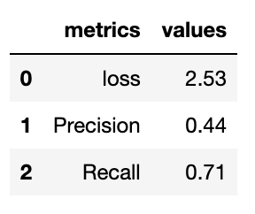
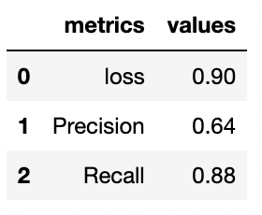
Performance
PERFORMANCE ON IMAGE DATA
PERFORMANCE ON TEXT DATA

Slide 7
Challenges faced
We were not able to train our image model satisfactorily.
We also tried to improve upon the LSTM model by using Bert but we were not able to train our model.
We were not able to combine the text and imaging model.

Slide 8
Thank You

